Slide 1
MIR lens designation
3/15/2026

Slide 2
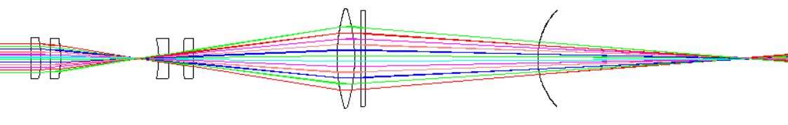
等效于
R₁ = x_{c}-x₁
R₂ = x_{c}-x₂
x₁
x₂
(x_{c},0)

Slide 3
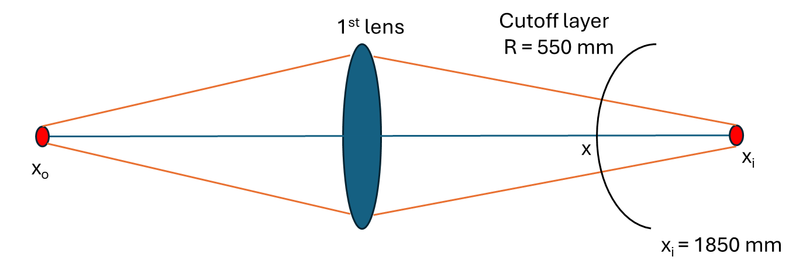
Y
X
=1550mm
=2100mm

Slide 4


d_antenna
d_zoom1_zoom2
天线
$$tan⁡(θ_{0})$$
$$tan⁡(θ_{i})$$
zoom1
zoom2
First lens
L= 4.590 m

Slide 5
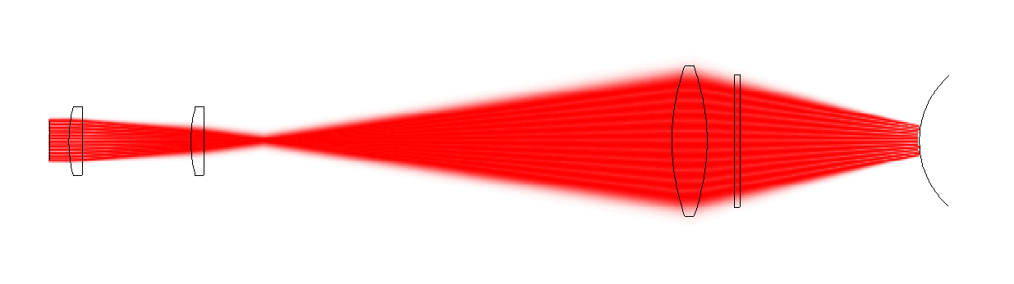
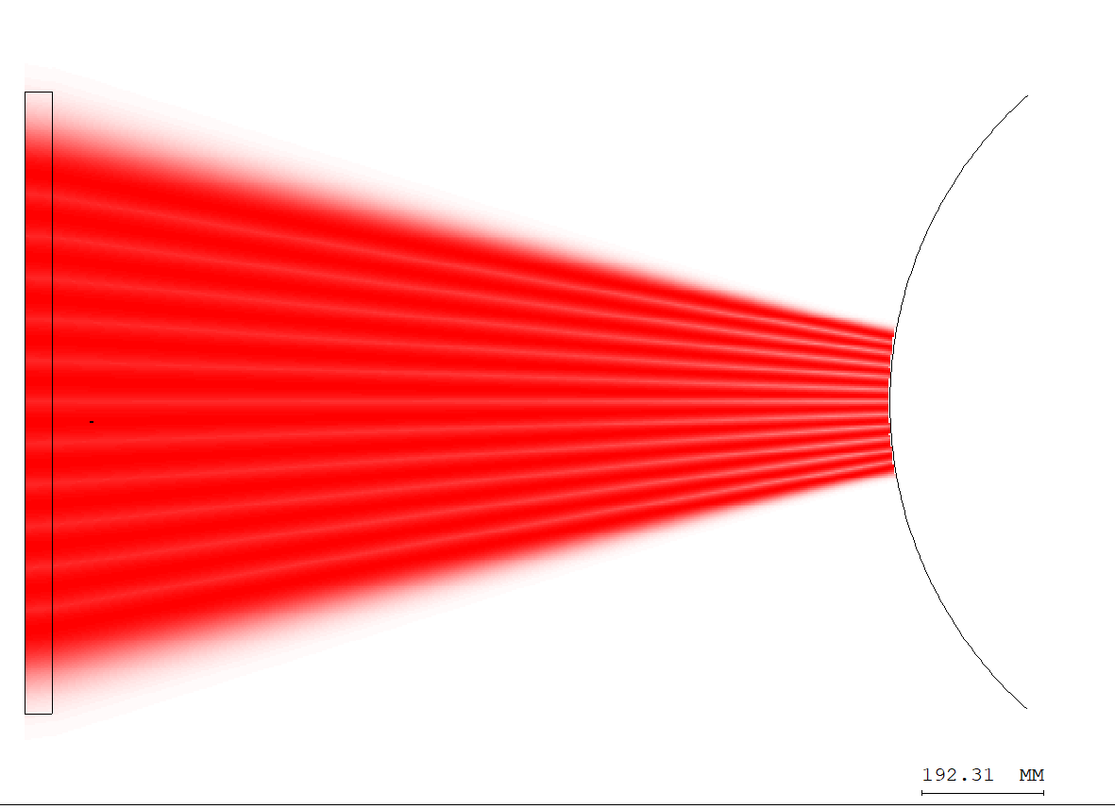

Slide 6
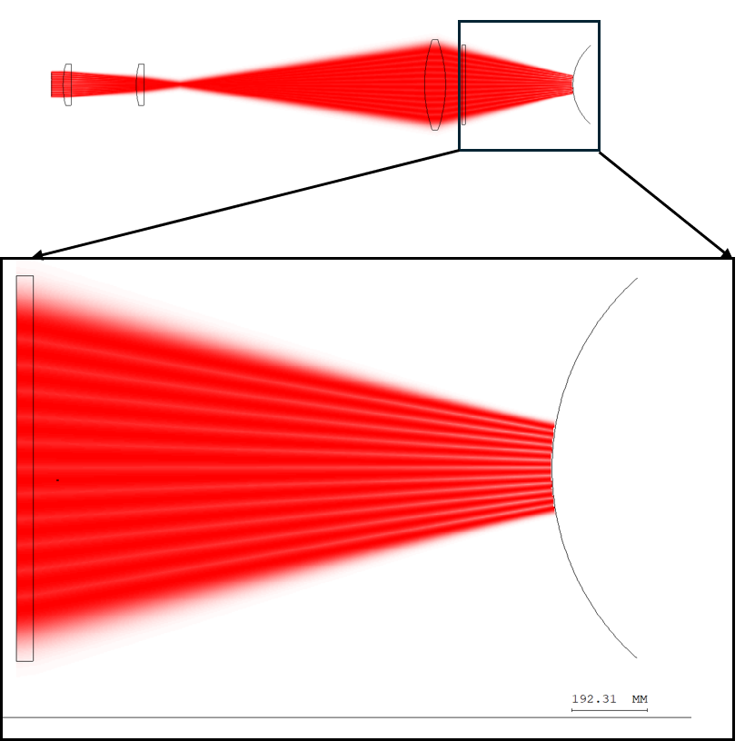
Window
Cutoff layer

Slide 7
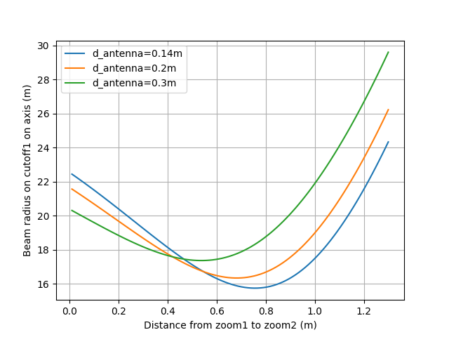
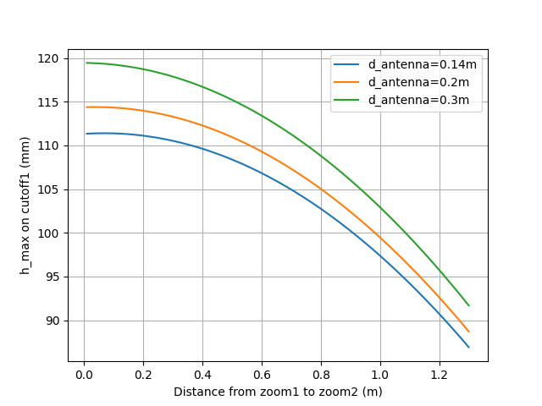
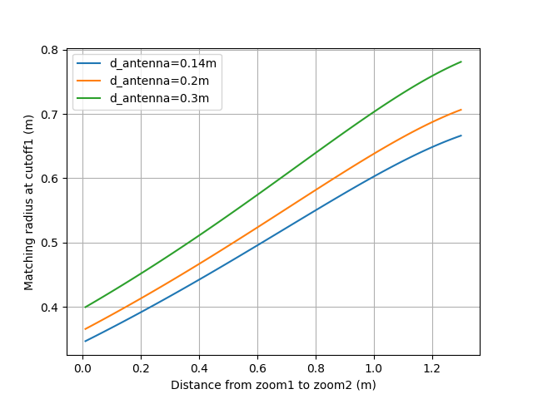
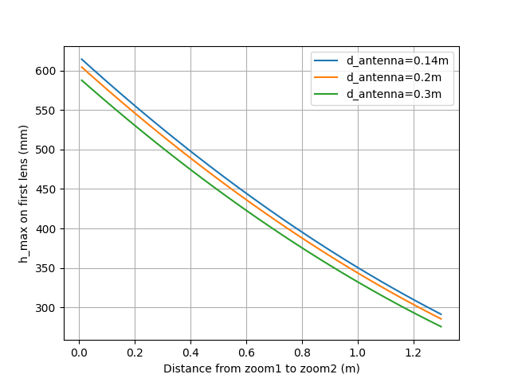
(a)
(b)
(c)
(d)

